Slide 1
Information Retrieval Systems
UNIT - IV

Slide 2
AGENDA
User Search Techniques: Search Statements and Binding, Similarity Measures and Ranking, Relevance Feedback, Selective Dissemination of Information Search, Weighted Searches of Boolean Systems, Searching the INTERNET and Hypertext
Information Visualization: Introduction to Information Visualization, Cognition and Perception, Information Visualization Technologies

Slide 3
Search Statements and Binding
What is a Search Statement?
A search statement is a user's input that expresses their information need.
This could be:
Boolean logic: oil AND Alaska AND price
Natural language: “Find me information on the impact of oil spills in Alaska on the price of oil.”

Slide 4
Binding: Translating Abstract Needs into Concrete Queries
“Binding” is the process of translating or mapping the user's abstract request into specific terms and formats that a computer system can process. There are three levels of binding:
User-Level Binding – Concept to Words
System-Level Binding – Query to Search Engine Metalanguage
Database-Level Binding – Match Query with Data

Slide 5
User-Level Binding – Concept to Words
At this stage, the user forms the query using their own vocabulary and past experiences.
This is where abstract thoughts become specific keywords like: "impact", "oil", "spills", "Alaska", "price"
The user may assign importance (weights) to some terms if the system allows.
Example:
User query: "Find me information on the impact of oil spills in Alaska on the price of oil." Extracted keywords: impact, oil (petroleum), spills (accidents), Alaska, price (cost, value)

Slide 6
System-Level Binding – Query to Search Engine Metalanguage
The search system interprets the query into its own internal format (called metalanguage) similar to how items were indexed in the system .
The system may use:
Statistical analysis (e.g., how often words appear in documents)
Natural language parsing (to understand grammar and meaning)
Concept mapping (to relate terms to known concepts)
Example:
The system may assign weights like:
impact (.308), oil (.606), petroleum (.65), spills (.12), accidents (.23), Alaska (.45), price (.16), cost (.25), value (.10)
These weights are based on algorithms like Inverse Document Frequency (IDF), which emphasizes rarer (more informative) words.

Slide 7
Database-Level Binding – Match Query with Data
The processed query is applied to the actual database.
The system uses:
Term frequencies (how often each term appears)
Concept indexing (matching against database-specific concepts)
Semantic understanding (what the terms mean in the context of the data)
For example, in a concept-based system:
The concepts used to index the documents might be statistically derived from the database itself.
Different databases may use different concept sets.
This level often involves real-time statistics:
Document Frequency: How many documents mention a term
Total Frequency: How often a term occurs overall

Slide 8
Length of Search Statements and Their Impact
Longer search statements → usually better performance.
Ex: SDI systems often use 75–100 terms.
Shorter queries (e.g., typical Internet search: 1–2 words) → less effective.
Harder to understand user intent
Reduces effectiveness of many IR (Information Retrieval) techniques

Slide 9
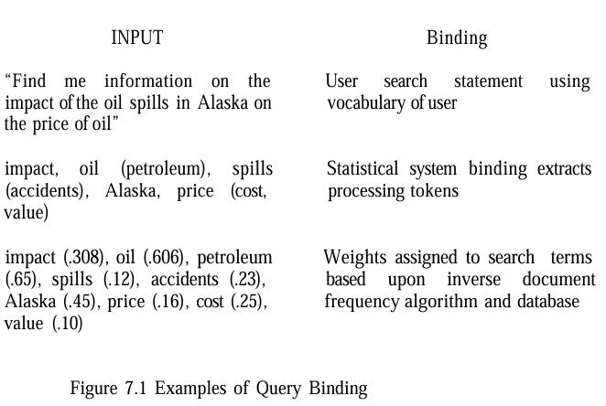
“Find me information on the impact of oil spills in Alaska on the price of oil.”
Step 1 – User Binding:
Extracted terms: impact, oil, spills, Alaska, price, etc.
Step 2 – System Binding:
Mapped to synonyms and given weights:
oil (.606), petroleum (.65) price (.16), cost (.25), value (.10) etc.
Step 3 – Database Binding:
Weights adjusted again based on document statistics and indexing semantics of that particular database.

Slide 10
Similarity Measures and Ranking
Concept | Meaning
Similarity | How closely a document or passage matches the search query
Weighting | Giving more importance to certain words
Passage-based retrieval | Comparing queries to parts of a document rather than the whole document
Locality-based similarity | Dynamically identifying meaningful content blocks
Ranking | Sorting search results by their similarity score

Slide 11

Similarity Measures - Simple Sum of Products
Simple Sum of Products
calculates similarity by summing the product of corresponding term weights between two items.
This is a basic approach but lacks normalization, which can lead to issues when items vary in length.

Slide 12

Similarity Measures - Croft’s Similarity Formula
Croft’s Similarity Formula
C is a tuning constant.
IDF_i is the inverse document frequency, which gives higher weight to rarer terms.
where: K is a tuning constant (typically 0.3 to 0.5).
TF_i,j is the frequency of term i in item j.
maxfreq_j is the maximum frequency of any term in item j.This formula adjusts term weights based on their frequency and rarity, improving relevance.

Slide 13
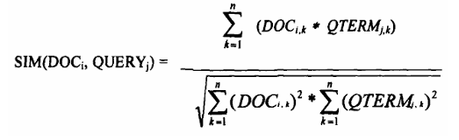
Similarity Measures - Cosine Similarity
Cosine Similarity
Measures the cosine of the angle between two vectors (document and query). A value of 1 means the vectors are identical (same direction), and 0 means they are orthogonal (unrelated).
The denominator normalizes for vector length, ensuring the result is between 0 and 1.
A variant (fourth equation) simplifies the denominator but still normalizes the score.

Slide 14

Similarity Measures - Query Term Weighting
Query Term Weighting
TF_{i,k} / maxfreq_k normalizes term frequency.
IDF_{i} boosts rarer terms.
The constants (0.5) balance the contribution of frequency and rarity.

Slide 15
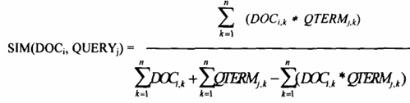
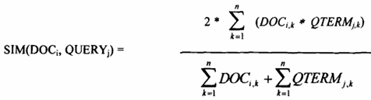
Similarity Measures - Jaccard and Dice Measures
Jaccard and Dice Measures
Jaccard : The denominator depends on the number of common terms, producing scores between -1 and 1. It penalizes dissimilarities more heavily.
Dice : The Dice measure simplifies the denominator and adds a factor of 2 in the numerator, also ranging from -1 to 1, but it’s less sensitive to the number of common terms.

Slide 16
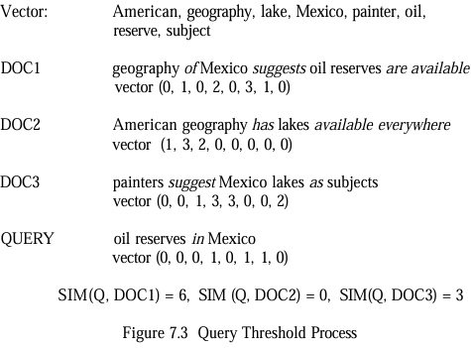
Similarity Measures - Jaccard and Dice Measures

Slide 17
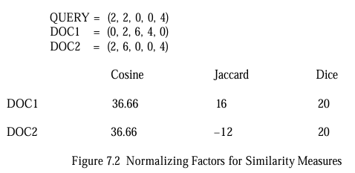
Similarity Measures - Jaccard and Dice Measures
The simple “sum of the products” similarity formula is used to calculate similarity between the query and each document. If no threshold is specified, all three documents are considered hits. If a threshold of 4 is selected, then only DOC1 is returned

Slide 18
Ranking Algorithms - Coarse Grain Ranking
Completeness:
Example: If the query has 5 terms and the item contains 3 of them (or their synonyms), the completeness is 3/5 = 0.6.
This sets an upper limit on the item’s rank. If query terms are weighted (e.g., some terms are marked as more important), those weights are factored into the score.
Semantic Distance
Synonyms (e.g., “buy” for “purchase”) increase the score, while antonyms (e.g., “sell” for “buy”) decrease it.
The closer the semantic relationship, the more weight is added to the ranking.
Contextual Evidence:
Example: If the query term is “charge” with the context of “paying for an object,” finding words like “buy,” “purchase,” or “debt” in the item suggests that “charge” is used in the desired sense, increasing the item’s score.
This helps disambiguate terms with multiple meanings (e.g., “charge” as in payment vs. “charge” as in an electrical charge).

Slide 19
Ranking Algorithms - Fine Grain Ranking
Proximity
A proximity factor is calculated, which is highest when terms are adjacent and decreases as the distance between terms increases.
Example: If the query terms “machine” and “learning” appear next to each other (e.g., “machine learning”), the item scores higher than if they are in different paragraphs (e.g., “machine” in the introduction and “learning” in the conclusion).
Impact of Proximity
In long documents, if query terms are widely distributed (e.g., one term at the beginning and another at the end), the fine grain rank can drop significantly, even to zero, despite the terms being present.
This reflects the intuition that scattered terms are less likely to indicate relevance to the query as a whole.

Slide 20

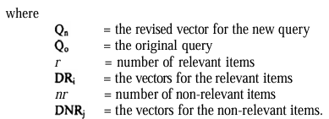

Relevance Feedback
The foundational work on relevance feedback was done by Rocchio (1971), building on vector representations of queries and documents. The idea is to adjust the query vector to increase the weight of terms found in relevant documents and decrease the weight of terms in non-relevant documents.
The revised Rocchio formula for query modification

Slide 21
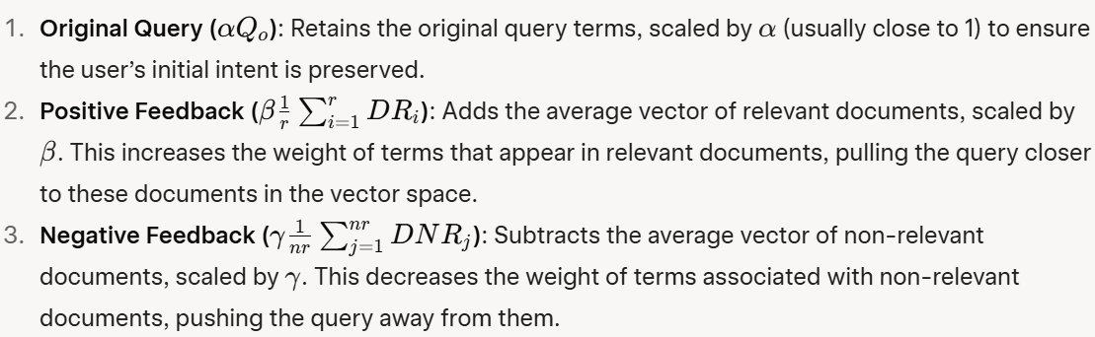
Formula Breakdown

Slide 22
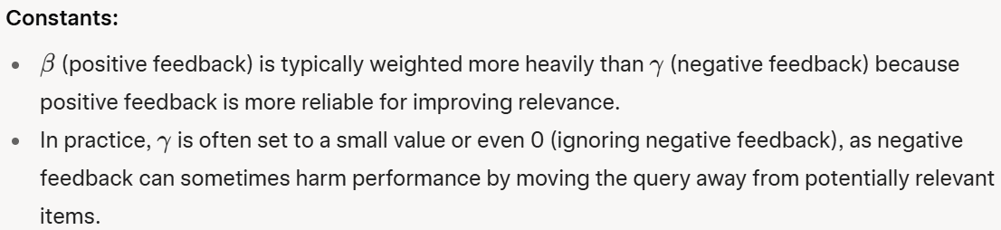
Formula Breakdown

Slide 23
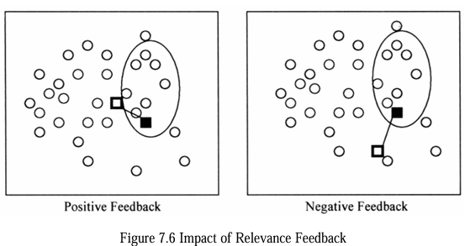
This figure visually shows how positive and negative feedback affect the query’s position in the document space:
Circles: Represent documents (filled circles are non-relevant, open circles are relevant).
Oval: The set of items retrieved by the query.
Solid Box: The original query’s position.
Hollow Box: The query’s position after feedback.
Positive Feedback (Left Diagram): The query moves toward the cluster of relevant items (open circles), increasing the likelihood of retrieving more relevant documents in the next iteration.
Negative Feedback (Right Diagram): The query moves away from non-relevant items (filled circles) but not necessarily closer to relevant ones, which can sometimes reduce effectiveness.

Slide 24
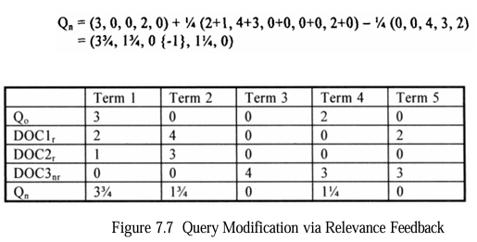
Query Modification via Relevance Feedback

Slide 25
Selective Dissemination of Information Search(SDI)
SDI systems, also called dissemination systems, automatically deliver new items to users when they match a user’s profile (a static query representing the user’s interests).
Key characteristics include:
Push vs. Pull: In SDI, the system pushes relevant items to the user as new data arrives, unlike search systems where users pull information via queries.
Profiles: These are static, broad search statements with many terms (hundreds, compared to a few in ad hoc queries), covering a user’s general information needs.
Time Parameter: Profiles are active as long as their time parameter is in the future, delivering items asynchronously to the user’s "mail" file.

Slide 26
Challenges in SDI Systems
Lack of Retrospective Data: Unlike search systems, SDI systems may not have a historical database to compute statistics like inverse document frequency (IDF) for weighting terms.
Profile Complexity: Profiles are large and complex, discouraging frequent user modifications.
Real-Time Processing: Systems like the Logicon Message Dissemination System (LMDS) process thousands of profiles every 20 seconds, requiring efficient algorithms.
Relevance Feedback: Applying relevance feedback in SDI is tricky due to the continuous nature of the process and the need to store past judgments.

Slide 27
Examples of SDI Systems
Logicon Message Dissemination System (LMDS):
Treats profiles as a static database and the new item as a query.
Uses a least frequently occurring trigraph (three-character sequence) algorithm to quickly eliminate profiles that don’t match the item, then analyzes potential matches in detail.
Personal Library Software (PLS):
Accumulates new items into a database and periodically runs profiles against it, sacrificing real-time delivery for the use of retrospective search software.
RetrievalWare and InRoute:
RetrievalWare: Uses a statistical algorithm that doesn’t rely on corpora data, comparing each profile to the item after filtering out irrelevant terms.
InRoute: Uses IDF, which it computes and updates as items arrive, stabilizing over time as more items are processed.

Slide 28
Statistical Classification and Error Minimization
SDI can be treated as a binary classification problem: for each item, decide if it’s relevant to a user’s profile (class 1) or not (class 0). Schutze et al. (1995) propose using statistical classification with explicit error minimization, but high-dimensional spaces (where each term is a dimension) pose challenges due to the need for large training sets.
Dimensionality Reduction
To make classification feasible, the dimensionality of the feature space must be reduced:
Feature Selection
Feature Creation (Local LSI)

Slide 29

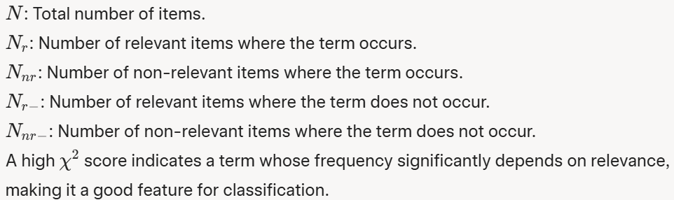
Feature Selection
Select a subset of existing features (terms) using a chi-squared ()test to identify the most important terms.
The first equation in the image is:

Slide 30
Feature Creation (Local LSI)
Use a modified Latent Semantic Indexing (LSI) technique to create a smaller set of concept vectors.
Unlike standard LSI (Chapter 5), this method creates a separate representation of terms and items for each profile, forming a "local" space of likely relevant items.
This reduces the number of LSI factors (dimensions) to a manageable level (e.g., fewer than hundreds), making processing feasible.

Slide 31
Learning Algorithms for Classification
Linear Discriminant Analysis (LDA)
Logistic Regression
Neural Networks

Slide 32

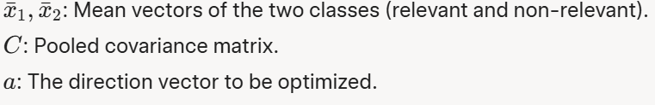
Linear Discriminant Analysis (LDA)
Goal: Maximize the separation between two classes (relevant and non-relevant) by finding a direction “a” that maximizes the distance between the class means, adjusted for the covariance structure.

Slide 33
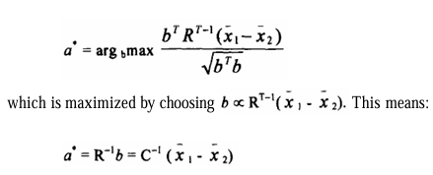
Simplification
then the formula becomes;
Regularized Discriminant Analysis (RDA): Introduces shrinkage parameters to combine pooled and unpooled covariance matrices, creating a non-linear classifier. However, this doesn’t significantly improve performance.

Slide 34




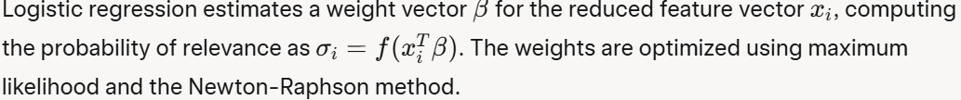
Logistic Regression
Models the probability of relevance as a binary response variable using a logit link function.
The sigmoid function used to model the probability :
The cross-entropy error minimized by logistic regression:
The sigmoid to the logit

Slide 35
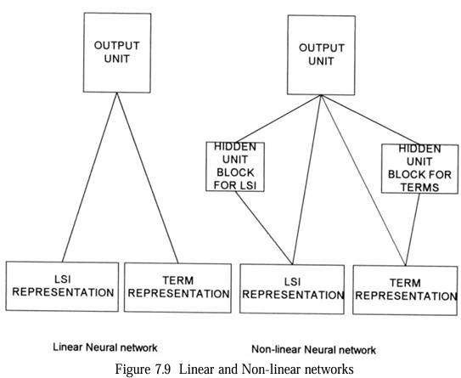
Neural Networks
Linear Neural Network (Left): Input units (LSI representation and term representation) are directly connected to the output unit.
Non-linear Neural Network (Right): Includes hidden blocks for LSI and terms, each with three hidden units acting as feature detectors, before connecting to the output unit.

Slide 36

Neural Networks
Function: Neural networks propagate input (document features) forward to compute relevance, then backpropagate errors to adjust weights.
Sigmoid Activation: Uses the sigmoid function (same as in logistic regression) to compute activations.
Error Minimization: Minimizes the cross-entropy error (same as logistic regression), using backpropagation and gradient descent.
Overfitting Prevention: A validation set is used during training to detect overfitting. If errors on the validation set increase, training stops to ensure generalization.

Slide 37
Weighted Searches of Boolean Systems
Boolean queries (e.g., "A AND B", "A OR B", "A NOT B") are traditionally strict—they return items that exactly match the conditions (e.g., both A and B for AND).
In weighted index systems (where terms have weights representing their importance)strict Boolean logic can be too restrictive (AND) or too general (OR), leading to suboptimal retrieval results.
Additionally, pure Boolean systems lack ranking, which is critical for user experience in information retrieval.
The goal is to combine Boolean logic with weighted systems to allow for fuzziness and ranking.

Slide 38

Fuzzy Set Approach (Fox and Sharat)
Fuzzy sets introduce the concept of "degree of membership" (DEG), allowing terms to partially belong to a set rather than strictly being in or out. This is useful for combining Boolean logic with weights.
Degree of Membership for AND and OR

Slide 39

Mixed Min and Max (MMM) Model
The MMM model calculates the similarity between a query (QUERY) and a document (DOC) as a linear combination of minimum and maximum weights of the terms:

Slide 40

Paice’s Extension of MMM
Paice expanded the MMM model by considering all term weights (not just min/max) and sorting them:
Similarity is calculated as:
This method requires more computation due to sorting but provides a more comprehensive use of weights.

Slide 41

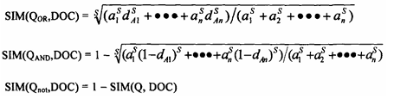
P-norm Model
For OR queries, the origin (all weights = 0) is the worst case; the best documents are farthest from the origin.
For AND queries, the ideal point is the unit vector (all weights = 1); the best documents are closest to this point.
Similarity formulas :

Slide 42
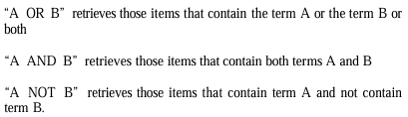

Salton’s Approach (No Weights in Indexes)
Salton’s method applies Boolean operations first, then refines results using weights.
Boolean Operations:
Weighted Interpretation:

Slide 43
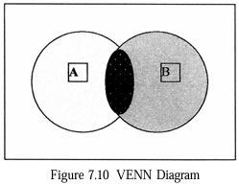
Two circles represent sets A and B.
Areas:
White:(A NOT B)
Black dotted:(A AND B)
Grey: ( B NOT A)
For OR:
At weight 0.0 for B, only A (white + black dotted) is included.
As B’s weight increases to 1.0, grey area (B NOT A) is added proportionally.
For AND:
At weight 1.0 for B, only black dotted (A AND B) is included.
As B’s weight decreases to 0.0, white area (A NOT B) is added.
For NOT:
At weight 0.0 for B, all of A (white + black dotted) is included.
As B’s weight increases to 1.0, black dotted (A AND B) is removed, leaving grey.

Slide 44
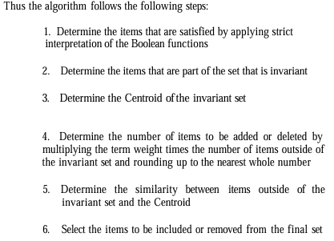
Algorithm

Slide 45
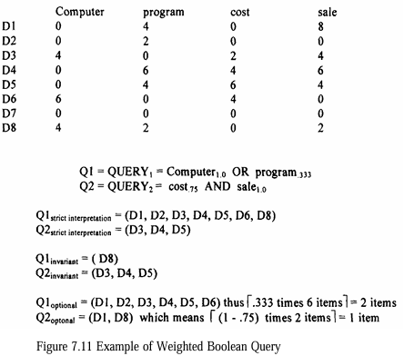
Example

Slide 46
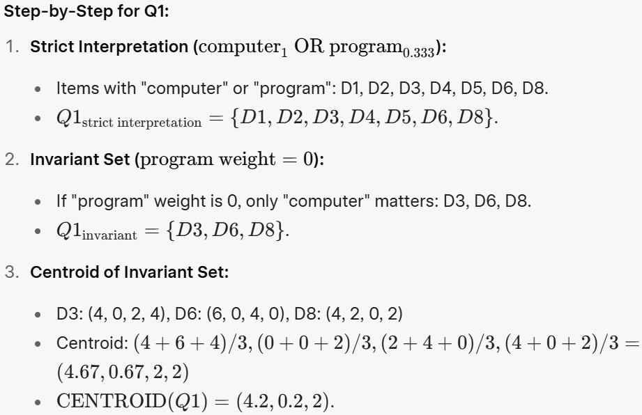
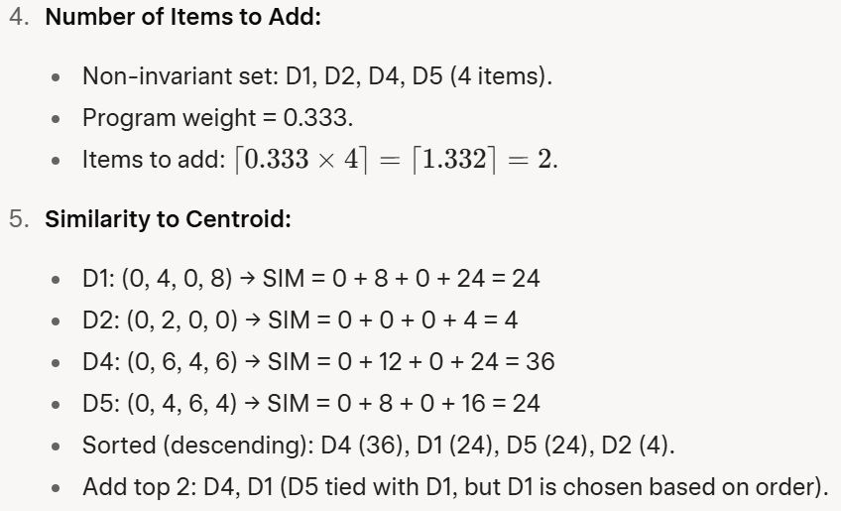
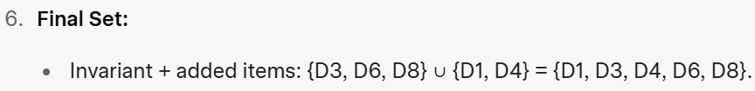

Slide 47
Searching the INTERNET and Hypertext
Internet Search Mechanisms
The Internet in the 1990s relied on search engines like Yahoo, AltaVista, and Lycos to help users find information. These search engines worked by:
Indexing Process: Automated processes (called crawlers or spiders) visited websites, retrieved text, and created indexes. These indexes stored references to web content, including URLs (web addresses), to help users locate relevant pages.
Lycos indexed only the home pages of websites, focusing on a limited scope.
AltaVista indexed all text on a website, providing a more comprehensive search.
Ranking Algorithms: Search results were ranked using simple statistical methods based on word frequency in the indexed text. This helped prioritize results most relevant to the user's query.

Slide 48
Six Key Characteristics Of Intelligent Agents
Intelligent agents were software programs designed to autonomously search the Internet for information based on user-defined needs.
Autonomy
Agents operated independently without constant human input, navigating websites based on predefined criteria to collect relevant information.
Communication Ability
Agents used standard protocols (e.g., Z39.50, a library search protocol) to interact with websites and retrieve data.

Slide 49
Six Key Characteristics Of Intelligent Agents
Capacity for Cooperation
Agents could work together or with other systems to achieve common goals, such as sharing search results.
Capacity for Reasoning
Rule-based: Followed user-defined conditions and actions (e.g., "if a page contains 'AI,' save it").
Knowledge-based: Learned from past actions to improve future searches.
Artificial Evolution-based: Created new, smarter agents to handle complex tasks.

Slide 50
Six Key Characteristics Of Intelligent Agents
Adaptive Behavior
Agents assessed their environment and adjusted their actions to better meet user needs, combining autonomy and reasoning.
Trustworthiness
Users needed to trust that agents would act in their best interests, retrieving relevant and accessible information.

Slide 51
Relevance Feedback:
Agents used a two-step process to improve searches by incorporating website-specific terminology. For example, if a user searched for "cars," the agent might learn to include terms like "automobiles" or "vehicles" based on site content.
A key challenge was determining how much learned information from one site should influence searches on other sites.
Agents also needed to normalize rankings across different websites to present the most relevant results first.

Slide 52
Hyperlinks and Hypertext Search
Hyperlinks are embedded links in web content (e.g., text or images) that point to other resources, typically via a URL.
They create a network of interconnected items, allowing users to navigate related content.
How Hyperlinks Work:
Clicking a hyperlink takes the user to another resource (e.g., a webpage, image, or document).
Hyperlinks were often static, lacking attributes to explain their purpose (e.g., whether they link to supporting content, related topics, or embedded media like images).

Slide 53
Hyperlinks and Hypertext Search
Challenges with Hyperlinks:
Understanding the context of a link was critical. For example, a link might point to:
Essential content (e.g., an image embedded in the page).
Supporting material (e.g., a reference to a related article).
Tangential topics the author thought might interest the reader.
Without attributes, users had to guess the link’s purpose, which could reduce its usefulness.

Slide 54
Hypertext Search
Users could manually follow hyperlinks to explore related content, creating a "network diagram" of interconnected items.
Automated systems could also follow hyperlinks to retrieve and index related content, but this required algorithms to weigh the relevance of linked items to the user’s query.

Slide 55
Emerging Search and Dissemination Systems
The text mentions several early Internet systems that personalized and delivered content to users:
Pointcast, FishWrap, and SFGATE:
These systems allowed users to specify interests (e.g., sports, news) and automatically delivered relevant content via email, file storage, or real-time screen updates.
Example: FishWrap (MIT) and SFGATE (San Francisco Chronicle/Examiner) provided customized news updates.

Slide 56
Firefly:
A recommendation system that learned user preferences for music or movies based on their interactions.
It compared a user’s profile with others to suggest products or connect users with similar interests.
Empirical Media:
Used collaborative intelligence, analyzing rankings from multiple users to predict what content might interest an individual.
For example, if users with similar tastes ranked a movie highly, the system would recommend it to others with similar patterns.
Collaborative Intelligence:
Unlike earlier research (e.g., Salton-83), which found limited success in using group queries to classify documents, the Internet’s massive user base (millions of interactions) enabled better clustering and learning for personalized recommendations.

Slide 57
Introduction to Information Visualization
Why Information Visualization Matters
Historically, IR systems have focused on algorithmic improvements (e.g., indexing, searching, clustering) rather than how information is displayed to users. This was due to:
Technological limitations: Early systems lacked the capability for sophisticated visual displays.
Academic focus: Researchers prioritized algorithmic challenges over human-computer interface (HCI) design.
Multidisciplinary complexity: Effective visualization requires integrating cognitive science, perception, and HCI.

Slide 58
Shift in Perspective: Visual Computing
The text argues that system designers should treat displays as visual computing platforms, not just digital versions of paper. This shift enables new functionalities:
Modify representations: Change how data is shown (e.g., adjust color scales).
Dynamic updates: Show changes in data while keeping the same visual framework (e.g., shifting between clusters to reveal new connections).
Animation: Display changes over time or space.
Interactive input: Allow users to navigate information spaces dynamically and customize displays to suit their preferences.
Hyperlinks: Let users create connections between data points to explore relationships.

Slide 59
Why Visualization is Critical
Even the best search algorithms (e.g., those tested in TREC) fall short of perfect precision and recall. This means users often face large sets of search results, many of which may not be relevant. Visualization helps by:
Reducing cognitive load: Presenting results in a way that’s easier for the human brain to process.
Highlighting patterns: Showing relationships and trends among items, rather than treating each result independently.
Guiding refinement: Helping users understand why certain results were retrieved and how to adjust their queries for better outcomes.

Slide 60
Cognitive Foundations
Cognitive engineering and perception studies provide the theoretical basis for visualization:
Mental depiction vs. description: Research since 1989 shows that visual representations (e.g., images, diagrams) are processed differently in the brain than text-based descriptions, playing a unique role in cognition.
Visual processing: The human brain is wired to process visual data efficiently, making visualization a powerful tool for understanding complex information.

Slide 61
Visualization
Visualization can be divided into:
Link visualization: Shows relationships between items (e.g., networks or connections).
Attribute visualization: Reveals content patterns across many items (e.g., how search terms influence results).

Slide 62
Historical Context
Doyle (1962): Proposed "semantic road maps" to give users a visual overview of a database’s content, allowing them to focus queries on specific themes.
Miller (1968): Emphasized spatial organization to map database information.
Sammon (1969): Developed a non-linear mapping algorithm to reveal document associations, enabling visual "road maps."
By the 1990s, technological advancements and the explosion of digital information made visualization a practical and commercially viable field.

Slide 63
User-Centric Design
The text emphasizes that interfaces should adapt to human needs, not force users to adapt to technology (per Donald Norman). Traditional text-based interfaces limit the brain’s ability to process information efficiently. Visualization addresses this by:
Reducing time to understand results: Visual summaries help users quickly grasp the scope of search results and identify relevant clusters.
Revealing relationships: Unlike text lists, visual displays show connections between items (e.g., linking researchers and dates in a polio vaccine search).
Simplifying complex actions: Users can perform intuitive actions (e.g., clicking a cluster) to refine searches or explore new topics.

Slide 64
User Needs and Research
A study by Fox et al. (1993) involving professionals in human factors, library science, and computer science identified key user needs:
Pattern exploration: Users want visual representations of document patterns and relationships.
Customizable focus: Interfaces should let users focus on specific areas of interest and explore emerging topics.
Trend identification: Visual tools should highlight trends and new areas of interest.
Challenges with Text-Based Results
Traditional IR systems present search results as ranked text lists, which are:
Hard to navigate: Users must read through long lists to understand results.
Limited in showing relationships: Text lists can only sort by one attribute (e.g., relevance), missing complex inter-item connections.

Slide 65
Cognition and Perception
The shift in user-machine interfaces from basic typewriter-like interactions to more complex systems like WIMP (windows, icons, menus, pointer) interfaces, which handle multiple tasks simultaneously.
As computer displays became common, the focus turned to representing information visually in ways that align with human cognitive processes.
The goal is to reduce the mental effort (cognitive overhead) users spend finding and understanding information by leveraging human perception—particularly vision, but also other senses like audio and touch.

Slide 66
Key Concepts in Human-Computer Interaction
Historical Context and Interface Evolution
Early interfaces treated displays as digital paper, focusing on operational consistency.
WIMP interfaces introduced complexity by allowing parallel tasks, requiring better ways to represent what’s happening in the computer environment.
Advances in technology and human information processing research now aim to optimize information flow through enhanced visualization and multisensory feedback.

Slide 67
Key Concepts in Human-Computer Interaction
Multisensory Interfaces
Audio: Historically used for alerts (e.g., beeps for errors), audio is now evolving into speech-based input/output. Researchers are exploring using pitch and sound to convey information (e.g., higher pitch for more relevant data).
Tactile (Touch): Virtual Reality (VR) experiments, like those in medical training, use tactile feedback to simulate real-world sensations.
Olfactory and Taste: These senses currently have no practical application in computer interfaces or information processing.

Slide 68
Key Concepts in Human-Computer Interaction
Focus on Information Visualization
For Information Retrieval Systems, the primary interest is in visualizing data effectively, as vision is the sense with the highest capacity for information transfer in humans

Slide 69
Background on Vision and Cognition
Gestalt Psychology: The mind organizes visual input into meaningful wholes using rules:
Proximity: Nearby objects are grouped together.
Similarity: Similar objects are grouped together.
Continuity: Smooth, continuous patterns are preferred (e.g., a circle with a line through it is seen as a circle and a line, not two half-circles).
Closure: Gaps are mentally filled to form a whole (e.g., a dashed square is still perceived as a square).
Connectedness: Linked elements are seen as a single unit.

Slide 70
Aspects of the Visualization Process
Preattentive Processing
Rotated Objects and Symmetry
Optical Illusions and Color
Configural Effects
Spatial Frequency
Natural Visual Processing
Challenges in Visualization

Slide 71
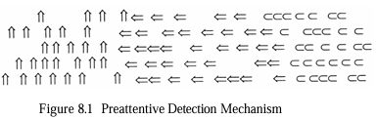
Preattentive Processing
The figure shows three groups of shapes: upward arrows (left), left-right arrows (middle), and "C" shapes (right).
The visual system quickly detects the boundary between the upward and left-right arrows due to orientation differences (preattentive).
Detecting the boundary between left-right arrows and "C" shapes requires more conscious effort because it involves different objects, not just orientations.
Preattentive processes are automatic, low-level, and preconscious. They detect basic visual features like borders or orientation changes quickly.
Implication: Information encoded in orientations (e.g., grouping by direction) is easier to detect than using different shapes, as it leverages the retina’s feature detectors.

Slide 72
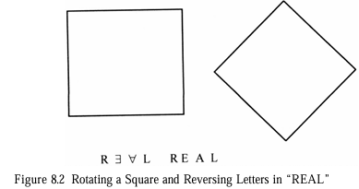
Rotated Objects and Symmetry
The figure shows a square (left) and a rotated square (right, now a diamond).
It also shows the word "REAL" with letters reversed.
The rotated square is harder to recognize as a square, and reversed letters are harder to read because they deviate from familiar orientations.
Recognizing rotated objects (e.g., a square turned 45 degrees) requires more cognitive effort than upright ones, as symmetry is easier to detect along vertical axes.
Figure 8.2 (Rotating a Square and Reversing Letters in “REAL”):
Implication: Interfaces should use familiar orientations (e.g., vertical/horizontal) to reduce cognitive load.

Slide 73
Optical Illusions and Color
A light object on a dark background appears larger than a dark object on a light background. Small objects in displays should use bright colors to stand out.
Color Use:
Colors (hue, saturation, lightness) are used to organize and enhance visuals. Humans are drawn to primary colors (red, blue, green, yellow) and retain them longer.
Depth Cues:
Monocular cues like shading, perspective, and occlusion depict depth. Brightness enhances depth perception more than contrast.
Depth/size recognition is learned early (Gibson and Walk, 1960, showed six-month-olds understand depth), making depth a reliable way to represent information.

Slide 74
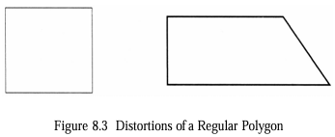
Configural Effects
Figure 8.3 (Distortion of a Regular Polygon): The figure shows a square (left) and a distorted square (right) with one side elongated.
The visual system quickly detects the distortion because it deviates from the expected equal-sided shape.
Configural clues allow quick recognition of abstract conditions by arranging objects in recognizable patterns.
Implication: Configural clues can substitute high-level cognitive processes with faster low-level visual ones, useful for monitoring systems (e.g., detecting anomalies in operations).

Slide 75
Spatial Frequency
The visual system constructs images from multiple channels (spatial frequency, orientation, contrast).
Spatial frequency measures light-dark cycles per degree of visual field.
Distinct images are easier to process for motion/changes than blurred ones, so certain spatial frequencies can help highlight patterns in dynamic displays.

Slide 76
Natural Visual Processing
The visual system is tuned to real-world patterns like horizontal/vertical references, subdued colors, and terrain/depth.
Bright colors in displays mimic natural attention cues (e.g., noticing bright flowers), and depth-based graphics align with everyday depth processing.
Implication: Visualizations should mimic real-world sensory experiences to reduce cognitive effort.

Slide 77
Challenges in Visualization
Context and Bias: Interpretation depends on the user’s background. Recent experiences can bias perception (e.g., seeing clusters where none exist if clusters were recently relevant).
Individual Differences: Past experiences shape how users interpret visuals, which may differ from the designer’s intent.

Slide 78
Information Visualization Technologies
Overview of Information Visualization in IR Systems
Information visualization applies theories of visual perception to design systems that help users locate and understand information more effectively.
In IR systems, the main goals are:
Document Clustering: Visually represent groups of documents based on content similarity, helping users navigate to relevant items.
Search Statement Analysis: Show why certain items were retrieved, aiding users in refining their queries by highlighting the impact of search terms.
These techniques are applied to search results, structured databases (like DBMSs), and link analysis (correlating data across documents). The diagrams showcase practical implementations of these concepts.

Slide 79
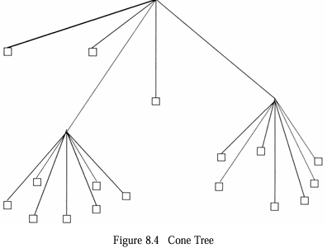
Hierarchical Visualization: Cone Tree and Perspective Wall
Hierarchical data (e.g., organizational structures or document clusters) can be visualized using tree structures.
However, traditional 2D trees become cluttered with large datasets, so 3D representations are used.

Slide 80
Hierarchical Visualization: Cone Tree and Perspective Wall
Description:
This is a 3D visualization from the Information Visualizer (Xerox PARC).
The tree’s root node is at the apex, with child nodes arranged in a circular base.
Each child node can be a parent to another cone, forming a nested structure.
Selecting a node rotates it to the front for focus.
Purpose: It shows the size and structure of subtrees, helping users understand the hierarchy and navigate to documents (represented as squares at the leaf nodes). Higher nodes may represent clusters or semantic centroids.
Example Use: In a document retrieval system, this could represent clusters of related articles, with leaf nodes as individual documents.

Slide 81
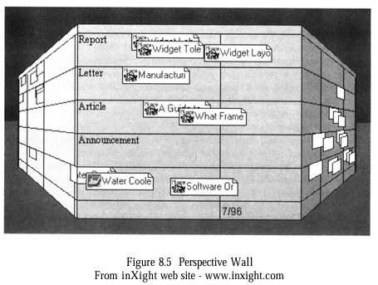
Hierarchical Visualization: Cone Tree and Perspective Wall
Description:
The Information Visualizer, this divides information into three areas:
a focused central area (e.g., "A GUI: The What Frame")
two out-of-focus side areas (e.g., "Report," "Letter").
The wall-like structure provides a perspective view.

Slide 82
Hierarchical Visualization: Cone Tree and Perspective Wall
Purpose: It allows users to focus on a specific area while keeping the broader context visible, aiding navigation in large datasets.
Example Use: In an IR system, this could display search results with the central area showing a selected document cluster, while side areas show related clusters.

Slide 83
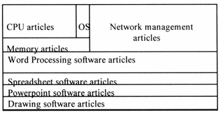
Tree Maps for Hierarchical Data
Tree maps use nested rectangular boxes to represent hierarchical data, maximizing screen space.
In this example, the map shows computer-related articles divided into categories like CPU, OS, Memory, Network Management, and others (e.g., Word Processing, Spreadsheet Software).
Purpose: The size of each box reflects the number of items in a category, and the layout indicates relationships (e.g., CPU and OS are grouped under operating systems, separate from applications).
Example Use: A user searching for computer articles can quickly see which topics (e.g., OS) have the most documents and explore related areas.

Slide 84
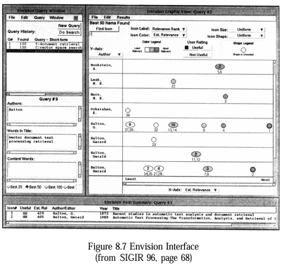
Search Statement Analysis: Understanding Query Impact
Query Window: Displays and allows editing of the search query.
Graphic View Window: A scatterplot where each icon (circle or ellipse) represents a document or cluster. Circles show single items with relevance weights, while ellipses indicate clusters.
Item Summary Window: Shows bibliographic details of selected items.

Slide 85
Search Statement Analysis: Understanding Query Impact
Purpose: It helps users visualize the distribution of search results and their relevance, making it easier to refine queries.
Example Use: A user searching for “machine learning” can see clusters of documents and their relevance scores, then adjust the query based on the scatterplot.

Slide 86
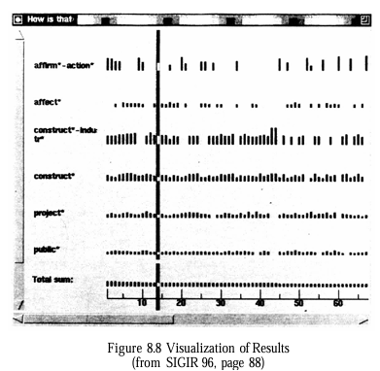
Visualization of Results
From SIGIR ’96, this shows a grid where columns represent documents and rows represent query terms (e.g., “affirmative-action,” “construct-industry”).
The height of bars indicates the weight of each term in a document.

Slide 87
Visualization of Results
Purpose: Users can see which terms most influenced retrieval (by scanning columns) and how terms contributed overall (by scanning rows), helping identify underperforming terms for query refinement.
Example Use: For the query “How affirmative action affected the construction industry,” a user might notice “construct” has low impact and adjust the query to include related terms.

Slide 88
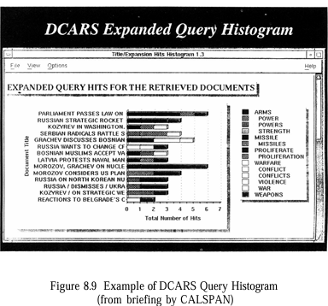
DCARS Query Histogram
From Calspan’s DCARS system, this histogram displays documents as rows, with tile bars showing the contribution of query terms (e.g., “arms,” “proliferation”) to retrieval.
The width of each bar reflects term importance.

Slide 89
DCARS Query Histogram
Purpose: It highlights why a document was retrieved, but it’s less effective for query refinement compared to Figure 8.8.
Example Use: A user searching for “arms proliferation” can see which terms drove the retrieval of each document, focusing on the most relevant ones.

Slide 90
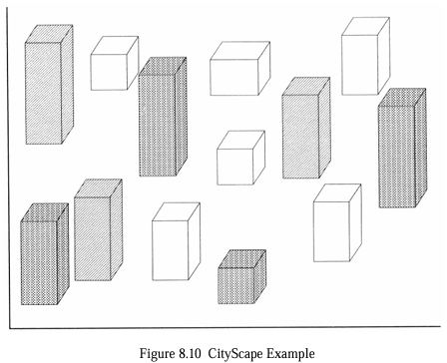
Cityscape for Thematic Representation
This uses a 3D “city” metaphor where skyscrapers represent themes or concepts (e.g., document clusters).
The height of buildings indicates the importance or size of the theme, and connections between buildings show relationships.

Slide 91
Cityscape for Thematic Representation
Purpose: It allows users to “move” through the cityscape, zooming in on specific themes to reveal more details, providing an intuitive way to explore complex data.
Example Use: In a news retrieval system, a user might see a tall building for “oil spill” with connected buildings for related events, navigating to explore specific articles.

Slide 92
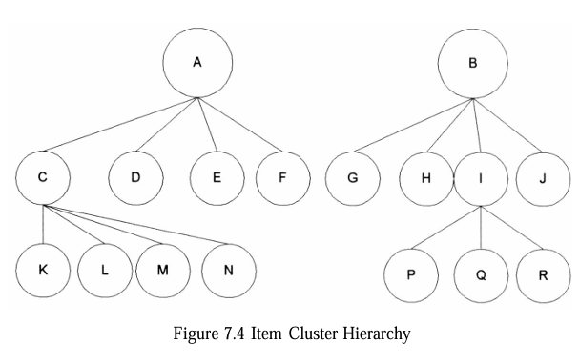
Item Term Clustering
This diagram shows a hierarchical clustering of items (represented by letters K, L, M, etc.) into clusters (A, B, C, etc.).
Nodes A and B are top-level centroids (averages of their child nodes).
C, D, E, etc. are sub-clusters or individual items.
In a search, the query is first compared to centroids A and B using a similarity measure (e.g., Cosine). If the similarity exceeds a threshold, the search proceeds to the child nodes (e.g., C, D, E under A). If not, that branch is pruned. This top-down approach reduces computation but risks missing relevant items if the centroid isn’t representative (e.g., items in cluster C might be relevant even if C’s centroid isn’t).

Slide 93
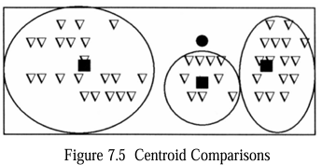
Centroid Comparisons
However, the left cluster has items (triangles) near the query, but its centroid is too far, so those items are missed.
This highlights a trade-off: centroids reduce computation but can lower recall (missing relevant items) if the cluster’s standard deviation is high.
The filled circle is the query.
The filled boxes are centroids of three clusters (ovals), with triangles representing individual items.
The query is closer to the centroids of the middle and right clusters, so only those might be searched further.

Slide 94
Overview - Hidden Markov Models Techniques
Search systems treat a query as a "document" and look for other documents similar to it using similarity measures.
However, HMMs shift this perspective:
Documents as Statistical Processes: In the HMM approach, documents are modeled as unknown statistical processes that can "generate" queries. Essentially, a document is considered relevant if it could have produced the user’s query.
Query as Output: The query is treated as the observed output of this process, while the relevant document is the "hidden" state the system tries to infer.
Noisy Channel Analogy: The mismatch between how an author expresses ideas in a document and how a user formulates a query is modeled as a "noisy channel." The HMM accounts for this noise in the process.

Slide 95

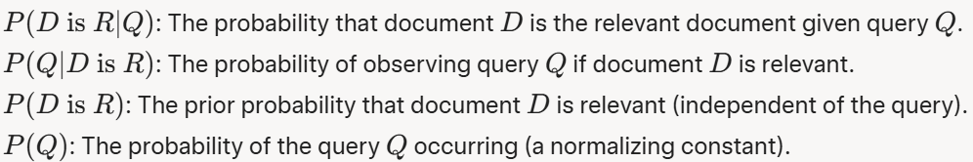



HMM - Bayes' Rule Application (Equation in Image)

Slide 96
HMM Structure for Search
States: Each document can be thought of as a sequence of states (e.g., the words in the document).
Transition Matrix : Defines the probability of moving from one state to another (e.g., from one word to the next).
Output Symbols : Each state (word in the document) can "output" query terms with some probability.
Output Probabilities : The probability of generating a specific query term given a particular state (word in the document).

Slide 97
HMM - How It Works:
State Transitions: The HMM moves through the states of a document (e.g., its words), with transitions governed by the transition matrix. These transitions reflect the structure of the document (how words are sequenced).
Query Generation: At each state, the HMM outputs query terms with probabilities defined by the output distribution. The idea is that a relevant document would generate query terms that match the user’s query.
Probability Calculation: Given the user’s query Q, the HMM calculates the probability that a document D could have generated Q by tracing through its states and summing the probabilities of all possible paths that produce Q

Slide 98
Challenges and Solutions
Transition Probabilities and Output Probabilities
Ideal Solution (Not Feasible):
Estimation-Maximization (EM) algorithm (e.g., Baum-Welch algorithm)
Practical Solution (Leek et al., 1999):
Lack of Training Data
Simplification
Independent Transition Matrix
Unigram Estimation for Outputs

Slide 99
Limitations
Data Dependency
Computational Complexity
Recall vs. Precision Trade-off

